Slide 1
A Seminar on Dual Access Control For Cloud Based Data Storage And Sharing
Team Details
G Keerteshwar Reddy (20EG105410)
Mahesh Pawar (20EG105424)
D Akhil (20EG105716)
Project Supervisor
E Radhakrishnaiah
Assistant Professor
1/24/2024
Department of Computer Science and Engineering

Slide 2
Introduction
What is cloud computing?
Cloud computing is the use of computing resources (hardware and software) that are delivered as a service over a network (typically the Internet). The name comes from the common use of a cloud-shaped symbol as an abstraction for the complex infrastructure it contains in system diagrams. Cloud computing entrusts remote services with a user's data, software and computation. Cloud computing consists of hardware and software resources made available on the Internet as managed third-party services. These services typically provide access to advanced software applications and high-end networks of server computers.
How Cloud Computing Works?
The goal of cloud computing is to apply traditional supercomputing, or high-performance computing power, normally used by military and research facilities, to perform tens of trillions of computations per second, in consumer-oriented applications such as financial portfolios, to deliver personalized information, to provide data storage or to power large, immersive computer games.The cloud computing uses networks of large groups of servers typically running low-cost consumer PC technology with specialized connections to spread data-processing chores across them. This shared IT infrastructure contains large pools of systems that are linked together. Often, virtualisation techniques are used to maximize the power of cloud computing.
Department of Computer Science and Engineering

Slide 3
Introduction
Cloud-based data storage service has drawn increasing interests from both academic and industry in the recent years due to its efficient and low cost management. Since it provides services in an open network, it is urgent for service providers to make use of secure data storage and sharing mechanism to ensure data confidentiality and service user privacy.
In this paper, we consider the dual access control, in the context of cloud-based storage, in the sense that we design a control mechanism over both data access and download request without loss of security and efficiency. Two dual access control systems are designed in this paper, where each of them is for a distinct designed setting. The security and experimental analysis for the systems are also presented.
Department of Computer Science and Engineering

Slide 4
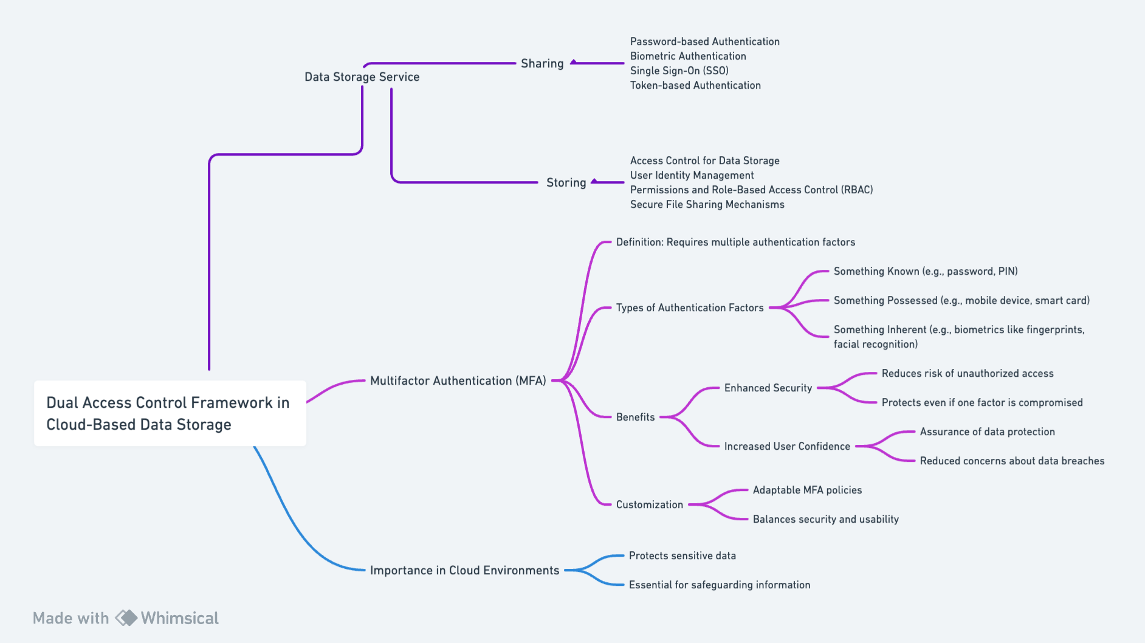
Concept Tree
Department of Computer Science and Engineering

Slide 5
Literature
Sl.No | Strategies | Advantages | Disadvantages
1 | MFA with Biometric Authentication | - Enhanced security through unique biological traits - Harder to fake or steal identity | - Privacy concerns - High cost of biometric devices - Risk of errors in biometric recognition
2 | MFA with SMS-based One-Time Passwords (OTP) | - Accessible to most users with a mobile device - Easy to implement | - Vulnerable to SIM swapping and interception - Reliance on mobile network availability
3 | MFA with Hardware Tokens | - Physical token is hard to duplicate - No internet connection required for token generation | - Risk of losing the token - Additional cost for hardware - Inconvenient for users to carry
4 | MFA with Software Authenticators (Apps) | - Convenient for users - Generates OTPs without the need for SMS or internet | - Requires a smartphone and app installation to device theft or hacking
Department of Computer Science and Engineering

Slide 6
Literature (selected strategy)
Sl.No | Author | Strategies | Advantages | Disadvantages
1. | Joseph A Akinyele, Christina Garman, Ian Miers | Tailoring MFA to specific needs and data types. | Ensures a precise security fit for different data types and requirements. | Requires in-depth analysis and understanding of diverse data and security needs.
2. | Ittai Anati, Shay Gueron, Simon Johnson, and Vincent Scarlata | Balancing security and user convenience. | Enhances security while maintaining user accessibility and compliance. | Risk of creating either too complex or too simplistic systems.
3. | Alexandros Bakas and Antonis Michalas | Using a variety of authentication factors. | Provides a range of secure and convenient options, like biometrics. | Managing diverse authentication methods can be complex.
4. | Amos Beimel | Prioritizing seamless user experience. | Encourages user adoption and satisfaction. | Balancing user convenience with robust security can be challenging.
5. | John Bethencourt, Amit Sahai, and Brent Waters | Developing customizable MFA policies. | Allows adjusting security based on user roles and data sensitivity. | Requires ongoing management and updates to policies.
Department of Computer Science and Engineering

Slide 7
Problem Statement
In the context of cloud-based data storage and sharing, the current challenge resides in establishing a robust and comprehensive access control system that ensures both security and flexibility.Existing single-layer access control mechanisms often fall short in adequately addressing the intricate demands of data security, leading to vulnerabilities and potential breaches.
To protect sensitive data from being compromised, the most widely used method is encryption. However, simply encrypting data (e.g., via AES) cannot fully address the practical need of data management. Besides, an effective access control over download request also needs to be considered so that Economic Denial of Sustainability (EDoS) attacks cannot be launched to hinder users from enjoying service.Implementation of a dual access control framework that effectively integrates multiple layers of authentication and authorization protocols.
Department of Computer Science and Engineering

Slide 8
Problem Illustration
Implementing a dual access control framework in cloud-based data storage and sharing is a crucial step towards bolstering security and flexibility. One fundamental aspect of this framework involves the integration of multifactor authentication (MFA) mechanisms. MFA enhances security by requiring users to provide two or more types of authentication factors before they are granted access. These factors typically include something they know (e.g., a password or PIN), something they have (e.g., a mobile device or smart card), and something they are (e.g., biometric data like fingerprints or facial recognition).
By demanding multiple forms of authentication, MFA significantly reduces the risk of unauthorized access, as even if one factor is compromised, an attacker would still need to bypass the additional layers of security. This makes it extremely challenging for malicious actors to gain access to sensitive data, even if they manage to obtain one piece of the authentication puzzle.
Department of Computer Science and Engineering

Slide 9
Proposed Method
Proposed Method:
Secure, Efficient, and Controlled Access to Cloud-Based Data:
Step-1: Design a Secure Authentication System
Step-2: Implement Role-Based and Attribute-Based Access Control
Step-3: Utilize Encryption for Data at Rest and in Transit
Step-4: Audit and Monitoring System
Step-5: User Training and Awareness
Step-6: Regular Security Assessments and Updates
Step-7: Data Backup
Department of Computer Science and Engineering

Slide 10
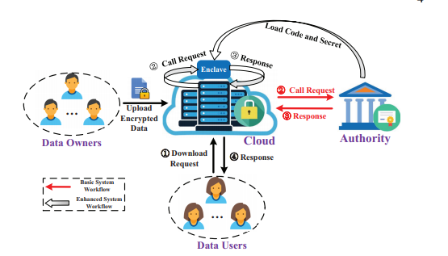
Proposed Method Illustration
The simple representation illustrates the flow of users authenticating, accessing data, storing data, and sharing data within the cloud-based system. Access control mechanisms are applied to control who can access or share data.
Department of Computer Science and Engineering

Slide 11
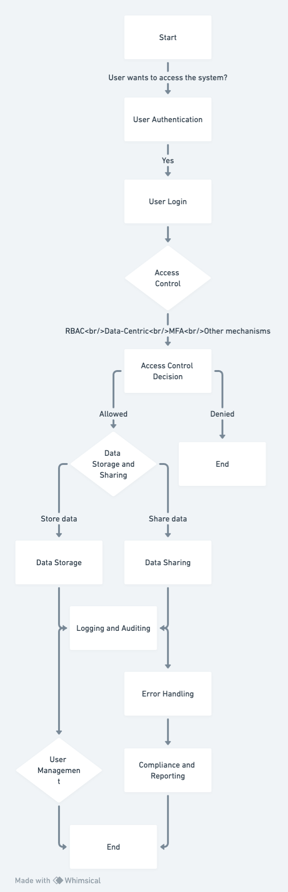
Proposed Method Illustration (Example)
Department of Computer Science and Engineering

Slide 12
Parameter
1.)Access Control Effectiveness (ACE):
ACE measures how well the dual access control system prevents unauthorized access to sensitive data. It can be calculated as:
ACE = (Number of Authorized Accesses) / (Total Access Attempts) * 100%
This formula provides a percentage that reflects the success rate of the access control mechanism.
2.)Data Availability (DA):
Data availability is crucial to ensure users can access their data when needed. It can be calculated as:
DA = (Total Uptime) / (Total Uptime + Total Downtime) * 100%
This formula calculates the percentage of time when the data storage and sharing system is available.
3.)Latency and Response Time (LRT):
Latency and response time are important for user experience. You can calculate the average latency as:
LRT = (Σ Latency measurements) / (Total number of measurements)
This formula calculates the average time it takes for the system to respond to user requests.
Department of Computer Science and Engineering

Slide 13
Experiment
Environment
Hardware Requirements
System : Intel Core i5 Processor
RAM : 8GB
Hard Disk : 1 TB HDD
Input Devices : Keyboard, Mouse
Software Requirements
Operating system : Windows 10.
Coding Language : JAVA.
Tool : Netbeans 8.2
Database : MYSQL
Department of Computer Science and Engineering

Slide 14
Project status
S.No | Functionality | Status (Completed /in-progress/Not started)
1 | Literature Survey | Completed
2 | Problem Definition | Completed
3 | Module Design | In-Progress
4 | Implementation | In-Progress
Department of Computer Science and Engineering

Slide 15
References
[1] Joseph A Akinyele, Christina Garman, Ian Miers, Matthew W Pagano, Michael Rushanan, Matthew Green, and Aviel D Rubin. Charm: a framework for rapidly prototyping cryptosystems. Journal of Cryptographic Engineering, 3(2):111–128, 2013.
[2] Ittai Anati, Shay Gueron, Simon Johnson, and Vincent Scarlata.Innovative technology for cpu based attestation and sealing. InWorkshop on hardware and architectural support for security and privacy (HASP), volume 13, page 7. ACM New York, NY, USA, 2013.
[3] Alexandros Bakas and Antonis Michalas. Modern family: A revocable hybrid encryption scheme based on attribute-based encryption, symmetric searchable encryption and SGX. In SecureComm 2019, pages 472–486, 2019.
Department of Computer Science and Engineering

Slide 16
References
[4] Amos Beimel. Secure schemes for secret sharing and key distribution.PhD thesis, PhD thesis, Israel Institute of Technology, Technion,Haifa, Israel, 1996.
[5] John Bethencourt, Amit Sahai, and Brent Waters. Ciphertext-policy attribute-based encryption. In S&P 2007, pages 321–334. IEEE,2007.
Department of Computer Science and Engineering

Slide 17
Thank you
Department of Computer Science and Engineering

Slide 18
Project seminar–I Evaluation
S.No | Rubrics | Marks
1 | Concept Introduction | 4
2 | Literature and Parameter | 5
3 | Problem and Problem Illustration | 8
4 | Proposed Method and Illustration | 8
Total |  | 25
Department of Computer Science and Engineering

